Slide 1
Cloud, IoT and Enterprise Security
Nishit Narang
WILPD-CSIS
(nishit.narang@pilani.bits-pilani.ac.in)

Slide 2
<SSCSZG570 , Cloud, IoT and Enterprise Security>
Lecture No. 3: Enterprise Security
Security as a Process + Securing Enterprise Network
Enterprise = Network + Systems + Data + Humans + …
Source Disclaimer: Content for many of the slides is from the course Textbook(s). Refer Course Handout for list of Textbooks.

Slide 3
Enterprise Security
Modern Initiatives and Impacts to Security Architectures

Slide 4
BYOD Initiatives
Bring your own laptop, cell, and tablet are a few of the new initiatives
This model is being used by many enterprises to reduce their IT budgets
Enterprise Security Architecture aspects:
how to properly secure the device(s)
secure the network it connects to, and
secure the data that these devices will have access and data they shall possibly store
Data access typically occurs through systems owned by the enterprise
In next couple of slides, we will look at two of the common BYOD initiatives and discuss considerations when applying trust models to attempt securing the data accessed, transmitted, and stored on these consumer end points

Slide 5
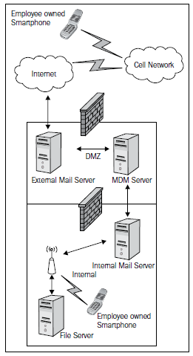
BYOD: Mobile Devices
Most mobile devices are cellular smartphones or tablets
Key use case is employee access to emails, calendar etc
Commonly implemented security measures include using a Mobile Device Management (MDM) solution
Generic platform - determining what exact data the device has access to will be up to the enterprise to decide
The enterprise will have to map the interaction to a defined trust model or develop one to meet this request
Source: Aaron Woody, Enterprise Security: A Data-Centric Approach To Securing The Enterprise

Slide 6
BYOD: Personal Computers
A more complicated initiative to secure, because maintaining a device by the enterprise that is not owned by the enterprise may cross some privacy and/or technical boundaries
However, there exist tremendous cost savings of allowing employees to bring their laptops to work to perform their jobs
Some enterprises are leveraging virtualization in a "trust no one" model where the only way to access anything is through a virtual desktop environment
model is very secure, but comes at a cost to build a robust enough infrastructure to support it
Other (generally smaller) organizations are allowing employees to bring their own PCs to access enterprise assets, with no virtualization and balancing access with risk
limit the access to all the data that has been assessed at a risk level of high and above, or to a level the enterprise's risk tolerance will allow

Slide 7
Security as a Process
Risk Analysis, Policies & Standards, Security Exceptions and Review of Changes

Slide 8
Overview
Security is a process that requires the integration of security into business processes to ensure enterprise risk is minimized to an acceptable level
We will introduce the concept of using risk analysis to drive security decisions, and to shape policies and standards for consistent and measurable implementation of security

Slide 9
Risk Analysis
Risk analysis is the process of assessing the components of risk; threats, impact, and probability as it relates to an asset, in our case enterprise data
A simple risk analysis output may be the decision to spend capital to protect an asset based on value of the asset and the scope of impact if the risk is not mitigated
It is the method to properly implement security architecture for enterprise initiatives
Without this capability, the enterprise will either spend on the products with the best marketing, or not spend at all
In the next few slides, we take a closer look at the risk analysis components

Slide 10
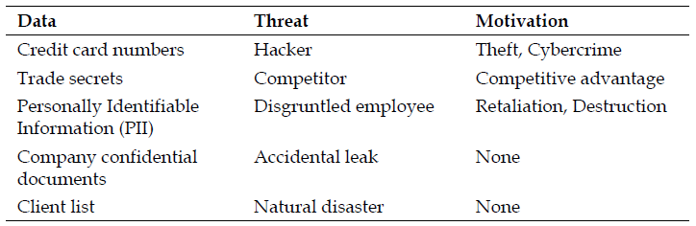
Threat Assessment
A threat is anything that can act negatively towards the enterprise assets
It may be a person, virus, malware, or a natural disaster
Once a threat is defined, the attributes of threats must be identified and documented
The documentation of threats should include the type of threat, identified threat groupings, motivations if any, and methods of actions
To gain understanding of pertinent threats for the enterprise, researching past events may be helpful
Example:
Source: Aaron Woody, Enterprise Security: A Data-Centric Approach To Securing The Enterprise

Slide 11
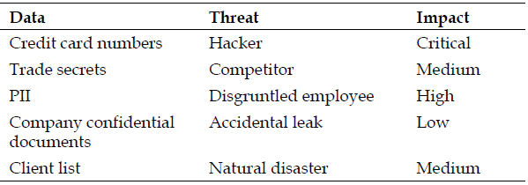
Impact Assessment
Impact is the outcome of threats acting against the enterprise. Examples:
a denial-of-service state where the agent, a hacker, uses a tool to starve the enterprise resources causing denial-of-service for legitimate users
the loss of customer credit cards resulting in online fraud, reputation loss, and countless dollars in cleanup and remediation efforts
Types of Impacts: Immediate and Residual
Immediate impacts are rather easy to determine
Residual impacts are longer term and often known later
Impact analysis needs to be thorough and complete. Example:
Source: Aaron Woody, Enterprise Security: A Data-Centric Approach To Securing The Enterprise

Slide 12
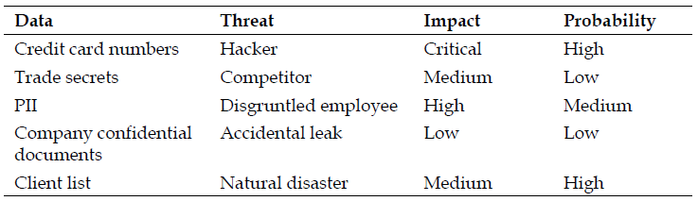
Probability Assessment
Probability is the likelihood of the Risk to mature
if threat actions may only occur once in three thousand years, investment in protecting against the threat may not be warranted
Probability data is as difficult, if not more difficult, to find than threat data
Probability and Impact are equally important to decide whether (or not) to handle a threat. It is the combination, normally, that matters
Example, in the game of Russian roulette, a semi-automatic pistol either has a bullet in the chamber or it does not. With a revolver and a quick spin of the cylinder, you now have a 1 in 6 chance on whether there is a bullet that will be fired when the firing pin strikes. How do you assess the Risk?
Source: Aaron Woody, Enterprise Security: A Data-Centric Approach To Securing The Enterprise

Slide 13
Assessing Risk
Now that we have identified threats to the data, rated the impact to the enterprise, and estimated the probability of the impact occurring, the next logical step is to calculate the risk of the scenarios
There are two methods to analyze and present risk: qualitative and quantitative
The decision to use one over the other should be based on the maturity of the enterprise's risk office/ team
In general, a quantitative risk analysis will use descriptive labels like in any qualitative method
However, there is more financial and mathematical basis involved in a quantitative analysis

Slide 14
Qualitative Risk Analysis
Qualitative risk analysis provides a perspective of risk in levels with labels such as Critical, High, Medium, and Low
The enterprise must still define what each level means in a general financial perspective
For instance, a Low risk level may equate to a monetary loss of $1,000 to $100,000
The dollar ranges associated with each risk level will vary by enterprise

Slide 15
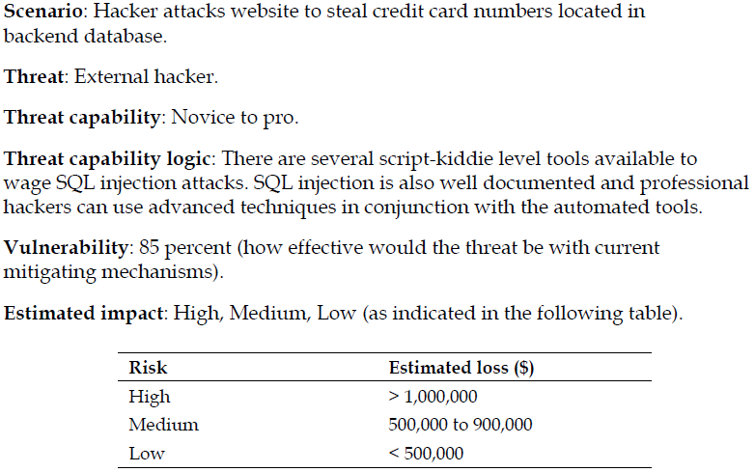
Qualitative Risk Analysis
Example Exercise:
Source: Aaron Woody, Enterprise Security: A Data-Centric Approach To Securing The Enterprise

Slide 16
Quantitative Risk Analysis
Quantitative risk analysis is an in-depth assessment of what the monetary loss would be to the enterprise if the identified risk were realized
In order to facilitate this analysis, the enterprise must have a good understanding of its processes to determine a relatively accurate dollar amount for items such as systems, data restoration services, and man-hour break down for recovery or remediation of an impacting event
Enterprises with a mature risk office will undertake this type of analysis to drive priority budget items or find areas to increase insurance, effectively transferring business risk
Ideally, the cost to mitigate would be less than the loss expectancy over a determined period of time. This is simple return on investment (ROI) calculation

Slide 17
Quantitative Risk Analysis
A Few Definitions:
Annual loss expectancy (ALE): The ALE is the calculation of what the financial loss would be to the enterprise if the threat event was to occur for a single year period
This is directly related to threat frequency
In a scenario, if this is once every three years, dividing the single lost expectancy by annual occurrence provides the ALE
Cost of protection (COP): The COP is the capital expense associated with the purchase or implementation of a security mechanism to mitigate or reduce the risk scenario
An example would be a firewall that costs $150,000. For a 3-year loss expectancy period, this is $50,000 per each year of protection
If the cost of protection (over the same period) is lower than the loss, it is a good indication the investment is financially worthwhile

Slide 18
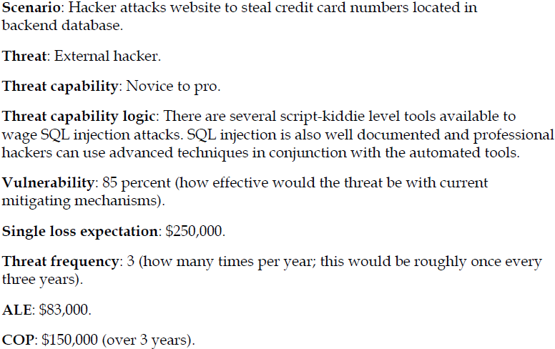
Quantitative Risk Analysis
Example Exercise:
Source: Aaron Woody, Enterprise Security: A Data-Centric Approach To Securing The Enterprise

Slide 19
Security Policies and Standards
Policy versus standard
Policy dictates what must be done, whereas Standard states how it gets done
A policy's intent is to address behaviors and state principles for IT interaction with the enterprise
Standards focus on configuration and implementation based on what is outlined in policy
Example:
An employee cell phone policy may be created in response to the business request to use personal phones for business
However, with the ability to use a personal cell phone, there may be restrictions on using the "smart" features to access enterprise data, or a requirement to load a mobile device management application on the cell phone
The standard in this scenario may be a requirement of a certain smart phone operating system type and version level. This may be driven by management and security capabilities of the platform
Role of Tools
Tools need to be implemented to measure compliance and provide enforcement of policies and standards

Slide 20
Security Policy Development
Driven typically by an outside driver such as regulatory compliance, industry certification, or business driver
regulatory compliance, example, Payment Card Industry Data Security Standard or PCI DSS
Typical set of security policies includes:
Information security policy
Acceptable use policy
Technology use policy
Remote access policy
Data classification policy
Data handling policy
Data retention policy
Data destruction policy

Slide 21
Information Security Policy
General policy that addresses all the security-specific requirements that may or may not be addressed in other policies
outline of what is expected from employees to ensure technology implementations and use are on par with enterprise security posture
Example, use of only secure protocols, logging requirements of systems, requirement for regular risk analysis etc
policy in effect makes known that IT security exists
provides the basis for the security team to protect the enterprise data. This includes giving the right to monitor employee use of systems and data access and install software to do so
What can be a starting point for a new organization?
SANS Security Policy Project has templates that can serve as a base or be used as is with little modification
https://www.sans.org/information-security-policy/

Slide 22
Acceptable Use Policy
A code of conduct, with consequences described for failure to comply!
may include items such as the network, employer provided equipment, website access, e-mail, and other use-based technologies
Focus of this policy is to reduce not only security risk to the enterprise but legal liability too
example policy statement: “employer-provided equipment must be used only for employer-sanctioned activities”
What services are employees permitted to use?
What services can be abused and introduce risk?
What is the consequence for violating the policy?

Slide 23
Technology Use Policy
May be developed separately from the acceptable use policy to call out specific technologies allowed and their approved use
Example, could be used to capture items such as BYOD initiatives or cloud initiatives
What is the technology?
How can it be used for better productivity?
What types of data can the technology access?
Who will be permitted to use the technology?
How will data and network access via the technology be managed?
……

Slide 24
Remote Access Policy
Defines what types of devices and who may connect to the enterprise network remotely
Includes the appropriate authentication methods such as two-factor or simple username and password
Some enterprises are very strict on employer-owned devices being the only method to use a VPN connection to the employer network

Slide 25
Data Classification Policy
In a data-centric model for security architecture, data classification is an absolute
must know what data exists, where it resides, and how to protect it
data should be mapped to a classification model that outlines its sensitivity and high-level protection requirements
Anytime new data is generated or old data discovered, it should go through the process of classification
Typically, data types will follow standard enterprise data labeling such as, confidential, restricted, and public
Based on the labeling, data protection scheme can be defined (e.g. Encryption, Restricted Access, or No Protection)

Slide 26
Data Handling Policy
This policy is prescriptive on approved interactions with enterprise data
Interactions may be people, applications, or automation
A closely integrated policy would be the data classification policy
Includes:
Acceptable storage for enterprise data
Enforcement of secure handling of appropriately classified data
Access and authorization procedures for sensitive data

Slide 27
Data Retention Policy
A data retention policy simply states the length of time to retain data in the enterprise
The general rule is to only keep data as long as needed for data recovery and regulatory requirements
Maintaining data for long periods of time significantly increases the risk of data leakage
possible damage to the enterprise can be reduced by enforcing data retention limits
This policy is tightly related to the data destruction policy

Slide 28
Data Destruction Policy
A data destruction policy provides an enforceable and measurable method to ensure data is properly destroyed
Example: sanitize hard drives before trashing them
Includes:
Requirement to securely wipe all functioning hard disks
Requirement to physically destroy non-working hard disks, tapes, and so on
If completed by third party, a formal process developed with verification
Labeling of systems with data that require destruction
Clear consequences for negligent data leakage

Slide 29
Enterprise Security Standards
Wireless Network Security Standard
wireless networking extends the network outside of the physical bounds of the brick-and-mortar enterprise
The following are a few examples of wireless network security standards:
Implementation of WPA2-Enterprise
Two-factor authentication using certificates
Enterprise Monitoring Standard
security monitoring of systems, networks, and users
necessary for both policy enforcement and as an implemented security mechanism
standard list of audit trail information

Slide 30
Enterprise Security Standards
Enterprise Encryption Standard
Data encryption required for data in transit, storage, or being processed
The following are the areas to focus on to standardize encryption :
Whole disk encryption
Database encryption
File-level encryption
Secure transport encryption
Key management is probably the most involved and difficult task with encryption
System Hardening Standard
reducing the attack surface of a system by
turning off unnecessary services,
patching the operating system and software, and
enabling attack mitigation features such as iptables for Linux and Windows Firewall for Windows
following are a few hardening guide sources:
NIST (http://csrc.nist.gov/groups/SNS/checklists/)
NSA (http://www.nsa.gov/ia/mitigation_guidance/security_ configuration_guides/operating_systems.shtml)
Microsoft (http://www.microsoft.com/en-us/download/details.aspx?id=16776)

Slide 31
Securing the Enterprise Network

Slide 32
What we will cover?
Notion of Defence-in-Depth
Securing each tier of the enterprise network to mitigate attacks against assets at each tier
Introduce multiple technologies that can be implemented in the network
secure enterprise infrastructure, network services such as e-mail, DNS, file transfer, and web applications
Advancement in firewall technologies
provide more in-depth inspection and protection capabilities
Intrusion detection and prevention
protect against simple and the most advanced attacks across applications, systems, and network services
Security through network segmentation

Slide 33
Defence In Depth
When developing an enterprise security strategy, a layered approach is the best method to ensure detection and mitigation of attacks at each tier of the network infrastructure
“Defence in depth is a military strategy that seeks to delay rather than prevent the advance of an attacker, buying time and causing additional casualties by yielding space. Rather than defeating an attacker with a single, strong defensive line, defence in depth relies on the tendency of an attack to lose momentum over time or as it covers a larger area.” Source: Wikipedia
Although the enterprise network perimeter is changing, the basic network security mechanisms still have their purpose
the same types of security mechanisms need to persist, however, where they are implemented may change slightly depending upon the network architecture
In general, we will not focus much on where the network perimeter is, but on what needs to be protected

Slide 34
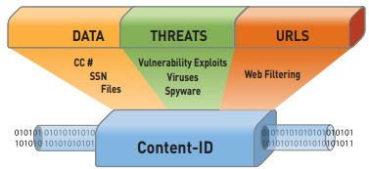
Next Generation Firewalls
Standard firewalls simply check for the policy allowing the source IP, destination IP, and TCP/UDP port, without a further deep packet analysis
Next Generation Firewalls (NGFW) perform more deep packet analysis to mitigate malicious traffic masquerading as legitimate
Example: DNS traffic inspected by a standard firewall may look legitimate, but in reality, the DNS packets may be padded with data that is being ex-filtrated from the network
An NGFW can inspect traffic for data, threats, and web traffic
Content_ID_tech.pdf (paloaltonetworks.com)

Slide 35
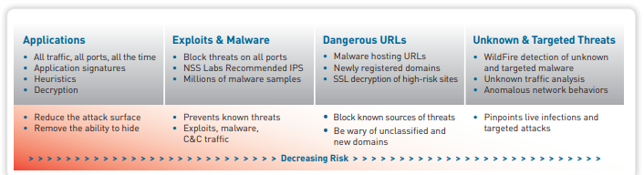
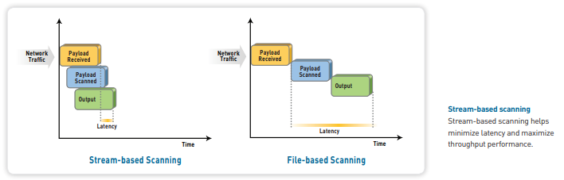
Case Study: Content-ID
Source: PALO ALTO NETWORKS
Single-pass architecture (SP3) integrates multiple threat prevention disciplines (IPS, anti-malware, URL filtering, etc) into a single stream-based engine with a uniform signature format
Allows traffic to be fully analyzed in a single pass without the incremental performance degradation seen in other multi-function gateways

Slide 36
NGFW: Benefits and Challenges
+ Most significant benefit of the NGFW is awareness due to deep-packet inspection and analysis
+ Reduced DMZ complexity - with next generation firewalls, new technologies become a part of the firewall tier, including intrusion prevention, user authorization, application awareness, and advanced malware mitigation
- This shift in firewall capabilities may add confusion to the role the appliance plays in the overall network protection
- In comparison to web application and database firewalls, while the next generation firewall provides some coverage across these areas today, the available platforms do not have the advanced capabilities of purposefully designed web application firewalls or database firewalls
NGFW is capable of basic detection and mitigation of common web application attacks, but lacks the more in-depth coverage provided by web application firewalls with database counterparts
Thus, implementing a NGFW in addition to web application and database firewalls provides the most comprehensive coverage for a network

Slide 37
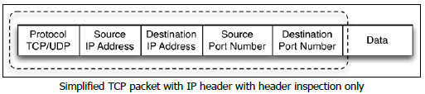
NGFW: Application Awareness
Traditional firewalls only look at the source and destination IP addresses and the TCP or UDP port to make a decision to block or permit a packet
NGFW is able to perform deep packet inspection to also decode and inspect the application data in network communication
Some firewall manufacturers, such as Palo Alto Networks, are able to identify over 3000 unique applications as traffic traverses the firewall
Offers ability to identify and take action on network traffic that violates security policy – e.g. torrent clients, anonymous proxy services, and tunneled connections back to a home, office, or other unapproved destinations

Slide 38
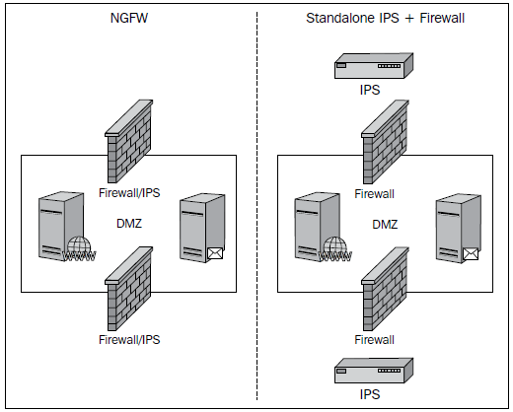
NGFW: Intrusion Prevention
Intrusion prevention coverage is normally required for every connection to the enterprise network
With the average cost of an IPS being over $40,000, this adds up quickly in addition to the support and maintenance costs
Simplifies management of IT security and the skillsets required to operationally support the solution
One less appliance in the DMZ - increases the performance
Source: Aaron Woody, Enterprise Security: A Data-Centric Approach To Securing The Enterprise

Slide 39
NGFW: Malware mitigation
The newest addition to the features that NGFWs are offering is advanced malware protection in the form of botnet identification along with malware analysis in the cloud
Performed by a solution built into the firewall, where the malware is examined in the cloud, protection developed and mitigation implemented by the manufacturer
While the next generation firewall implementation is less mature than the standalone solutions, leveraging the cloud and the vendor's entire customer base to provide samples will increase the effectiveness and value of the feature

Slide 40
IDS/IPS
Intrusion detection and prevention technology has remained a mainstay at the network perimeter
While several firewall technologies are integrating intrusion prevention into their offerings, there has not been a complete shift to this implementation
Intrusion detection is a method for detecting an attack but taking no action
this has been abandoned at the network perimeter when a breach is undesirable
it seems to still have a significant implementation in the internal network server segments to passively observe the behaviors of internal network users
has all the detection logic of intrusion prevention but without the ability to actively mitigate a threat
Intrusion prevention is similar to intrusion detection, but has the capability to disrupt and mitigate malicious traffic by blocking and other methods
Many IPS devices have purposefully built denial of service mitigation technology
can be deployed at the network perimeter
should also be considered for implementation in the internal network to protect the most critical assets within the organization
As the attacks have become advanced, there is debate on the overall advantage of the IDS/IPS
However, a defense in-depth strategy is best implemented by including IDS/IPS as an essential network protection mechanism

Slide 41
IDS/IPS: Detection Methods
IDS/IPS devices use a combination of three methods to detect and mitigate attacks
behavior, anomaly, and signature
initial IDS/IPS systems were specialized in one method or another
Today, it is rare to find a detection method without the others
Also because attacks are not always as simple as protocol misuse or a known Trojan signature

